Slide 1

FactElytics | Drishti 2k21 | SIOM, Nashik
Data analytics approach, Insights, Interpretations and recommendations.
Chandraraj Singh – B.Tech – Manipal Institute of Technology, Manipal

Slide 2


Introduction
Generating profits for a banking institution by increasing
Term Deposits subscription
There has been a revenue decline for the bank, and they would like to know what actions to take. After investigation, it was found that the root cause is that their clients are not depositing as frequently as before. Term deposits allow banks to hold onto a deposit for a specific amount of time, so banks can lend more and thus make more profits. In addition, banks also hold better chances to persuade term deposit clients into buying other products such as funds or insurance to further increase their revenues.
As the leader of marketing and analytics team, approach to the ‘Term Deposit’ campaign, is divided into 3 very important aspect :
Segment of population – Which segment of population the campaign will address.
Distribution channel to reach the customer's place – Which medium is to be used.
Promotional Strategy – How the campaign will be promoted.

Slide 3
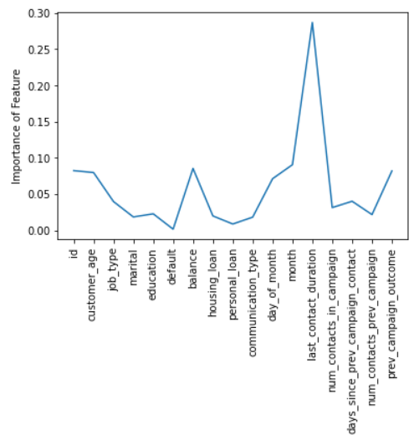
Data Exploration
Distribution, feature examination and analysis:
The dataset is slightly skewed towards people with secondary level of education and married marital status, which also represent the distribution of general population.
Correlation analysis and feature importance from a tree-based ML model signifies the gravitas of some features like contact duration, balance, age and previous campaign outcome in determining the target feature(Term deposit subscription).
Around 3,900 bank accounts have negative balances, implying customers tried to make payments larger than the amount in their account.
This led to another insight; only about 5% customers with negative bank balance tend to not shy away from subscribing for term deposit, whereas for customers with positive balances have a subscription percentage of 11%.
Further, subscription percentage rate gradually increases with increase in balance.
Month has a significant impact on the reach as well as the success of the campaign. May to August being the most prominent part of the campaign.

Slide 4
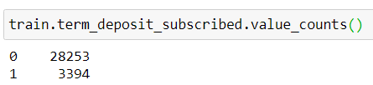
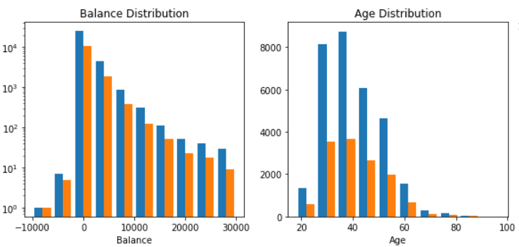
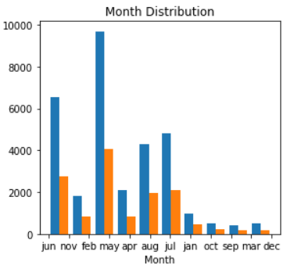
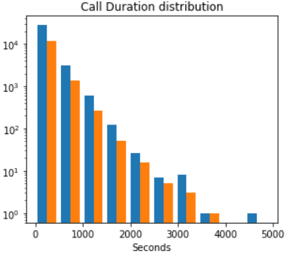
Data Exploration
Cellular and telephone communication types are the most efficient with 13% success rate. “unknown" has an efficiency of only 3.5%. “unknown” is prominent on the months of May and June. For the remaining months, it has negligible contribution in terms of campaign reach.
The target value, “term_deposit_subscribed” is skewed with only 10% of customers taking the subscription.
The distribution of train and test appears to be the same. Thus, improving model on training set will also improve the predictions on test set.
Train
Test

Slide 5
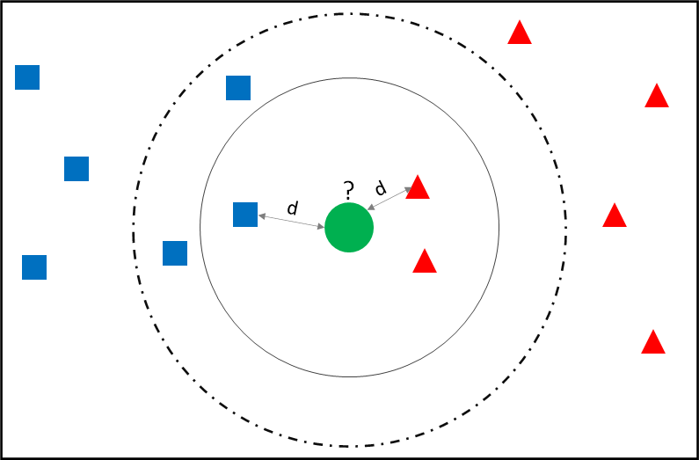
Data Preparation
NaN values, encoding, scaling and sampling:
Data preparation will be focused around a Neural Network model.
Imputing values using KNN Imputer (nearest neighbour imputation) is more effective than just using mean, mode or median to fill NaN values for features. A new sample is imputed by finding the samples in the training set “closest” to it and averages these nearby points to fill in the value.
Combining the power of correlation with KNN imputer by using features which have significant correlation with a particular feature and passing them to the KNN Imputer to avoid additional noise by other less correlated features.
Balance and customer age have highest correlation. Using one of these to fill NaN values of the other.
Outliers are clipped using appropriate thresholds for features like balance, contact durations and contact days.
Features are scaled to have zero mean and unit variance. This helps faster in convergence of gradient. Gradients in Neural Networks tend to explode or vanish on unscaled features.
Missing Value Imputation using KNN
Combining "personal_loan" and "housing_loan" to generate a new feature "loan“ which represent both the initial features and helps in improving the model by a small margin.

Slide 6
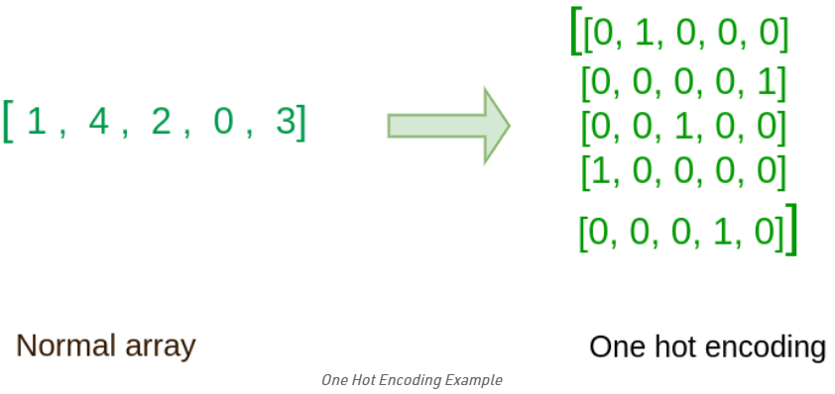
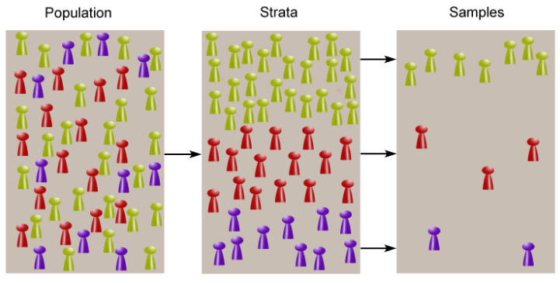
Data Preparation
Education is an ordinal feature and thus is label encoded. This helps in preserving the feature’s ordinance.
Categorical features other than “month” and “job_type” are One-Hot Encoded. For a Neural Network architecture, One-Hot encoding is more effective in recognizing patterns than Label/Frequency Encoding.
OHE “month” and “job_type” did not prove to be efficient from model’s point of few, due to large number of distinct categories. Therefore, both features are label encoded and then scaled.
Because of skewed target values, Stratified shuffle split is used so the distribution of target values are the same in train and validation set. This is a very significant when working with skewed data.
Using Stratified split technique ensures that there will be selection from each sub-groups (subscribed and not subscribed) and prevents the chance of omitting one sub-group leading to sampling bias, which results in a poor performing model on new data.
Example of Stratified Sampling

Slide 7

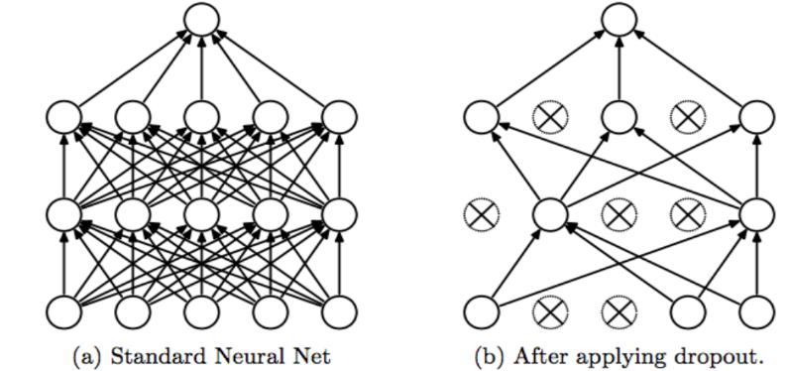
Model Development
Neural Network Model
Neural Network comprising of 6 Dense layers with ReLu activation, 1 output layer with Sigmoid activation (Binary classification task), and 4 Dropout layers with dropout rate of 0.4, to tackle overfitting.
Dropout is a technique where randomly selected neurons are ignored during training. This helps in reducing the “dependency” on previous neurons and helps to generalize the model, thus helping with overfitting.
Adam optimizer is used for model optimization with a function which calculates F1 score after every epoch with “AUC” as metrics. Model has total 14,497 trainable parameters.
Training data is split into validation and training set with validation size of 20%.
Model is trained for 200 epochs resulting in validation F1 score around 0.580 and ‘AUC’ around 0.928. For training set, F1 score is around 0.600 and ‘AUC’ around 0.950.

Slide 8
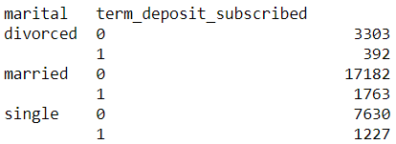
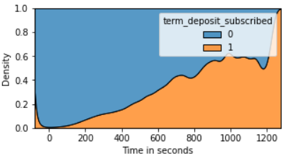
Interpretation and recommendations
After analyzing tons of insights, rejecting and confirming many hypotheses, some recommendation to the bank to get a promising result for the next campaign is :
Focusing on certain customer demographics like customers with:
Positive balances, if not high.
“single” marital status.
Management, student or unemployed job types.
Successful subscription in previous campaign are most likely to subscribe again.
If the last contact duration was high, the chances of the customer subscribing is high, as longer duration implies interest of the customer in services offered by the bank. Hence, duration of last call is an important marker while prioritizing reach.
Reach via cellular and telephonic mediums should be prioritized as they have a much higher success rate.

Slide 9
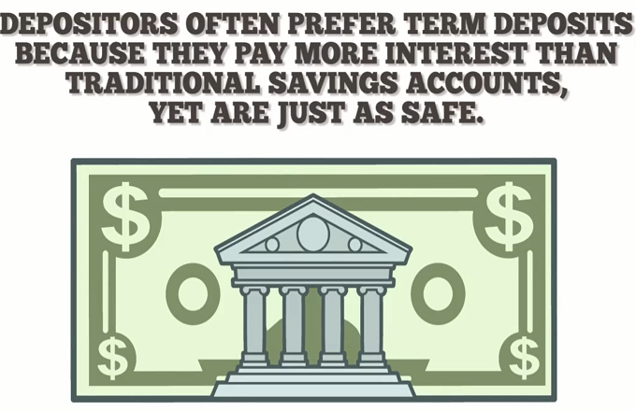
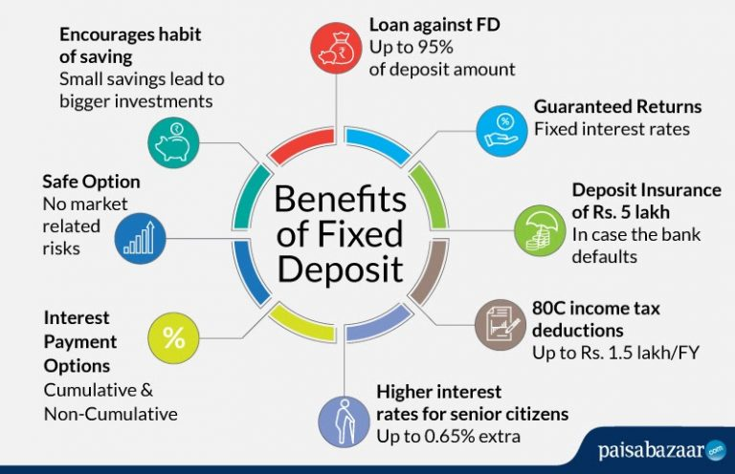
Interpretation and recommendations
To further improve the outcome of the next campaign following steps can be taken by the baking institution :
Notch up data collection by gathering family info for the customer, number of family income sources, how the costumer would rate their job security and other such factors that reflect upon the long term behaviour of the customer and their chances of subscribing to long term deposits.
Banks could use the most efficient modern day medium, social media, to spread awareness amongst the youth regarding finances, it’s importance and related procedures.
According to ETMONEY India Investment report 2020, we are witnessing a large participation in the investment market coming from millennials. This wave of millennials taking active interest in finances should be treated as next high priority customers for baking services.
[All insights and observations are well documented in a descriptive Jupyter Notebook written in Python.]

Slide 10
Thank you
Files attached with this presentation –
.csv file of test predictions
Jupyter Notebook saved as HTML

